Slide 1
Product recommendation
– fit and flatter
july 2017
PLATFORM ANALYTICS

Slide 2
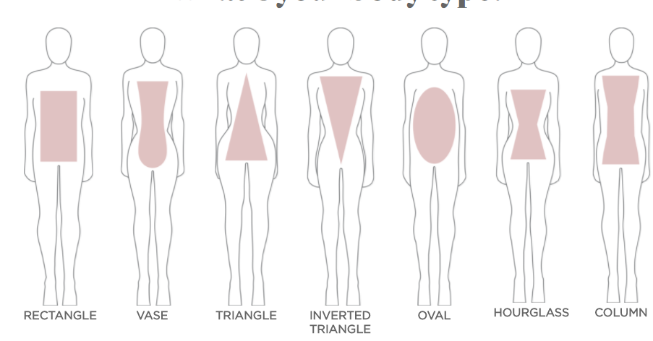
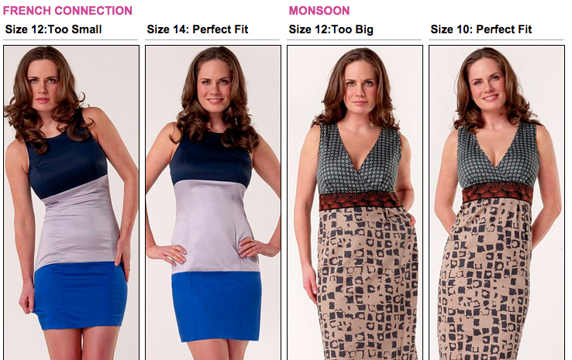
Business Objective and Background
Business Background and problem
Mass customization of fit across segments
Most of the GAP brands are struggling with Ecommerce business low return rate or repurchase rate
One of the drawback of ecommerce platform is customers do not get to touch and feel the products they intend to buy
Fit and size definition (HML) is subjective and varies from people of one ethnic background to another
Wrong or inaccurate sizing of products leads to bad customer experiences thereby resulting in customers not returning to shop again
Hence, getting the right fit is integral to good ecommerce experience
Brands try to promote browse traffic with deep discounts
Aspect of product fit can be seriously taken and tested whether that can lead traffic and repurchase rate
Potential Business Outcome
Enabling repeat purchase by having emotional connection with customers
Shift in business model by moving away from being discount heavy to providing Delightful customer experience
Reduce fit based returns and increased order size

Slide 3
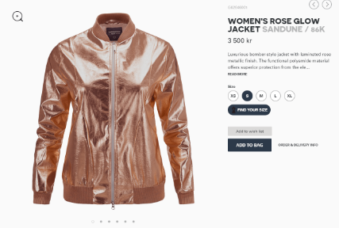
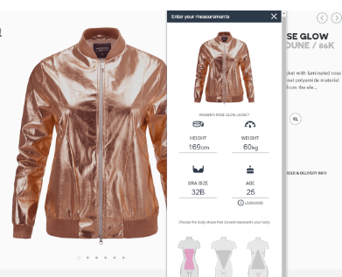
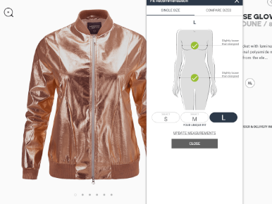
Analytical Approach to Problem
Solution Approach
Data Driven solution Algorithm
Various approaches available to solve the problem of getting right fit
One approach is to get 3d scanning and virtual fitting platforms, which is expensive and require substantial IT investments because the amount of fashion product assortments for our brands are huge
Another more strategic approach is find data driven solutions
When customer comes to shopping she may be asked optionally to fill for perfect fit
Similar customers height, weight, body type can be predicted from exhibited shopping and browsing history
Two stage recommender algorithm to run
Step 1: Get the right style color code level recommendation
Step 2: Map the recommendation with right fit to show when customer returns to website
Same findings can be used for email campaigns as well
Images taken from https://fits.me

Slide 4
Thank you

